Slide 1

COMBINED ARTHROSCOPIC REPAIR OF ROTATOR CUFF RUPTURE AND BANKART LESION ASSOCIATED WITH ANTERIOR DISLOCATION OF THE SHOULDER
Dr LOIZOS CHRISTODOULOU
Aretaeio Private Hospital
Nicosia,Cyprus
29.09.2011

Slide 2
COMBINED ARTHROSCOPIC REPAIR OF ROTATOR CUFF RUPTURE AND BANKART LESION ASSOCIATED WITH ANTERIOR DISLOCATION OF THE SHOULDER
Scope of the paper :
The purpose of this study was to investigate the postoperative results of simultaneous arthroscopic repair of Bankart lesion and rotator cuff tear after recent anterior dislocation of their shoulder

Slide 3
COMBINED ARTHROSCOPIC REPAIR OF ROTATOR CUFF RUPTURE AND BANKART LESION ASSOCIATED WITH ANTERIOR LOCATION OF THE SHOULDER
METHOD:
Nine patients sustained simultaneous Bankart lesion and rotator cuff tear after recorded anterior dislocation between 2005-2009.
Mean age: 61 years(range 48-70 )
Two patients had dislocation twice to the same shoulder
All patients had Xrays and MRI scan to their shoulder. Mean period of operation after injury 6,5 months.
Mean follow up after surgery: 2 years.

Slide 4
COMBINED ARTHROSCOPIC REPAIR OF ROTATOR CUFF RUPTURE AND BANKART LESION ASSOCIATED WITH ANTERIOR DISLOCATION OF THE SHOULDER
Another 17 patients during this period (2005-2009) with rotator cuff tear and accidental finding of Bankart lesion in MRI scan without dislocation were excluded.
Mechanism of injury :
Eight pts had a fall in outstretched arm
One patient had a fall during snow ski
Demographics :
Six men, three women
In 6 patients the dominant arm was affected

Slide 5
COMBINED ARTHROSCOPIC REPAIR OF ROTATOR CUFF RUPTURE AND BANKART LESION ASSOCIATED WITH ANTERIOR DISLOCATION OF THE SHOULDER
Preoperative clinical assesement :
The primary symptom was pain
All complained of shoulder instability
and weakness of active flexion and abduction .
Positive apprehension test
Active flexion, mean 135°
Passive flexion, mean 160°
Active abduction, mean 110°
Passive abduction, mean 130°

Slide 6
COMBINED ARTHROSCOPIC REPAIR OF ROTATOR CUFF RUPTURE AND BANKART LESION ASSOCIATED WITH ANTERIOR DISLOCATION OF THE SHOULDER
Preoperatively all nine pts:
Negative apprehension in opposite shoulder
Sulcus sign negative bilaterally
None of patients reported pain or instability or weakness of active flexion/abduction before the dislocation

Slide 7
COMBINED ARTHROSCOPIC REPAIR OF ROTATOR CUFF RUPTURE AND BANKART LESION ASSOCIATED WITH ANTERIOR DISLOCATION OF THE SHOULDER
Preoperative MRI and Intraoperative findings :
Eight patients had Bankart lesion and one pt a small bony Bankart lesion
Mean rotator cuff tear : 2,5 cm (1,5 cm -4cm)
(mostly supraspinatus and infraspinatus)
Five pts had Crescent type tear
One pt had L Shape tear
Three patients had massive RC tear (U shape) with
exposed biceps tendon and detachment upper part
subscupularis.
Another two patients had concominant SLAP lesion type II

Slide 8
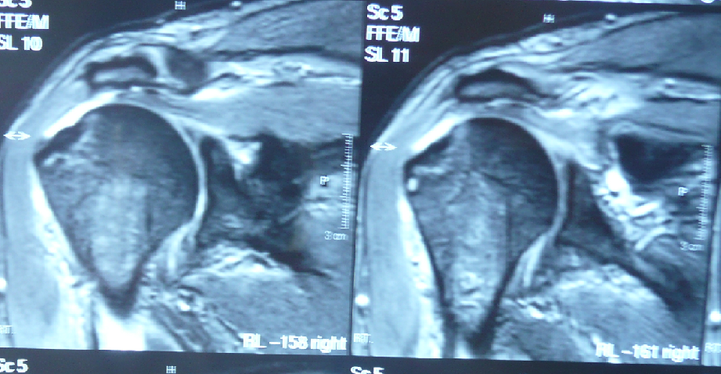
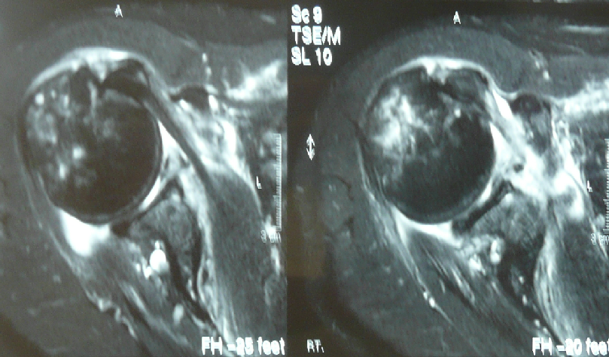
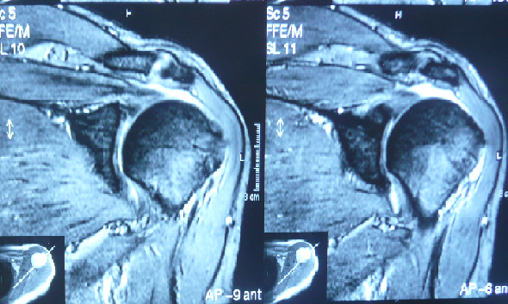
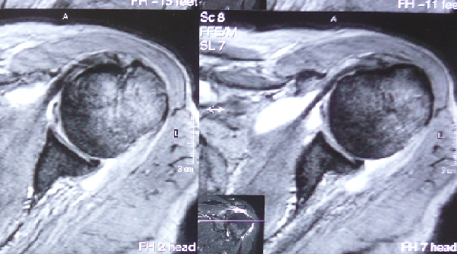
COMBINED ARTHROSCOPIC REPAIR OF ROTATOR CUFF RUPTURE AND BANKART LESION ASSOCIATED WITH ANTERIOR DISLOCATION OF THE SHOULDER

Slide 9
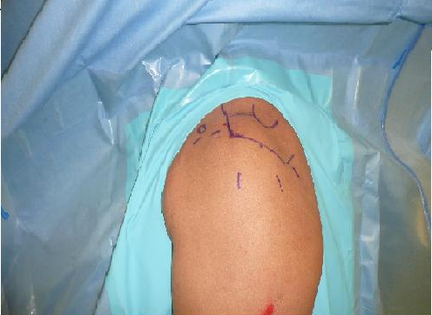
COMBINED ARTHROSCOPIC REPAIR OF ROTATOR CUFF RUPTURE AND BANKART LESION ASSOCIATED WITH ANTERIOR DISLOCATION OF THE SHOULDER
PORTALS :
Posterior portal
Anterior portal
Anterosuperior portal
Lateral portal
Accessory portals
Left shoulder posterior
portal

Slide 10
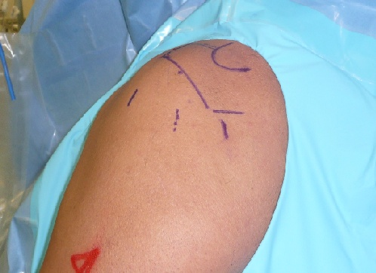
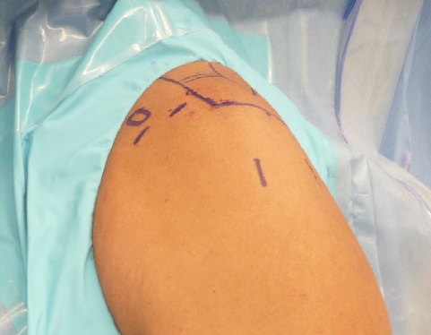
COMBINED ARTHROSCOPIC REPAIR OF ROTATOR CUFF RUPTURE AND BANKART LESION ASSOCIATED WITH ANTERIOR DISLOCATION OF THE SHOULDER
The posterior portal was 1 cm inferior
and 1 cm medial to the posterolateral acromion
The anterior superior portal was mild
laterally because we used it during RC repair
Left shoulder

Slide 11
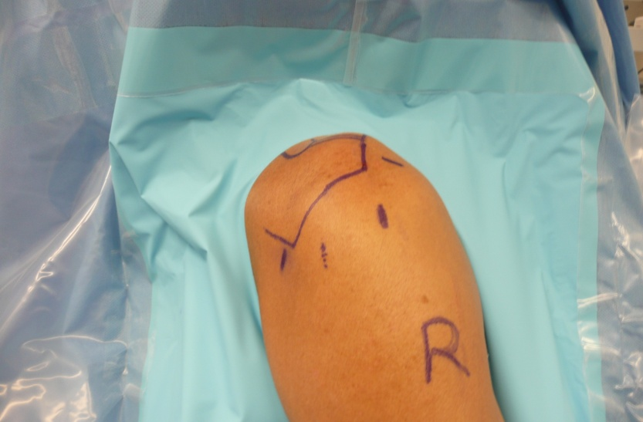
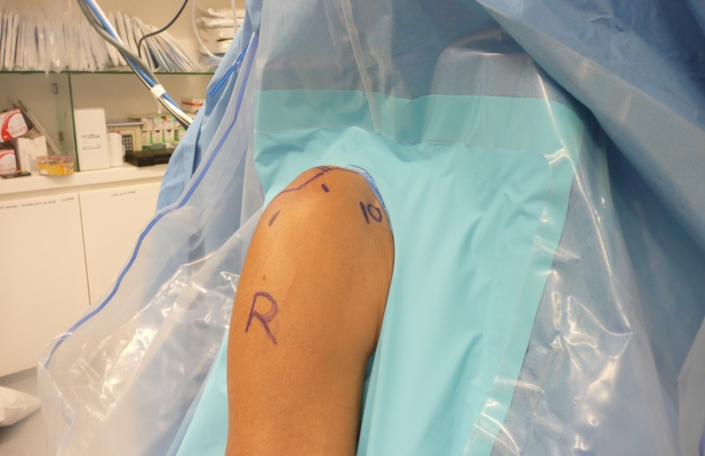
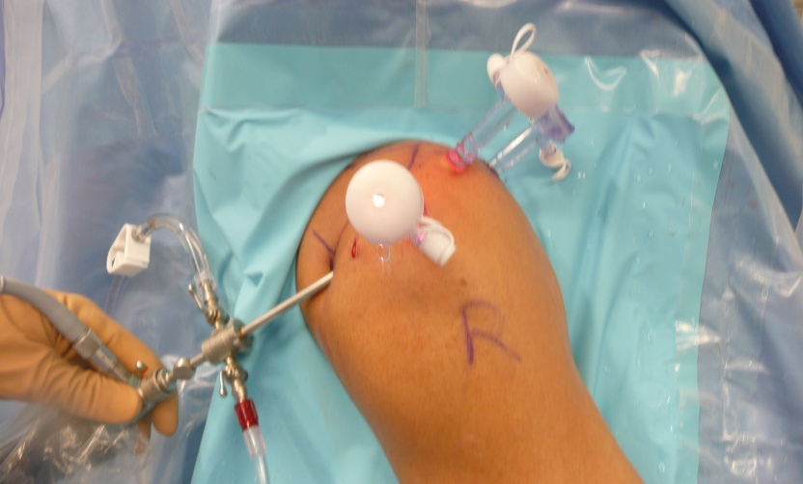
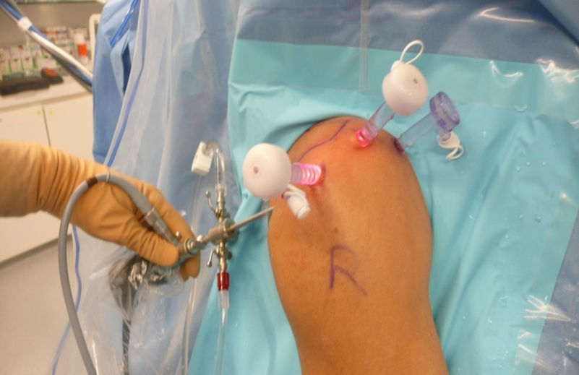
COMBINED ARTHROSCOPIC REPAIR OF ROTATOR CUFF RUPTURE AND BANKART LESION ASSOCIATED WITH ANTERIOR DISLOCATION OF THE SHOULDER

Slide 12
COMBINED ARTHROSCOPIC REPAIR OF ROTATOR CUFF RUPTURE AND BANKART LESION ASSOCIATED WITH ANTERIOR DISLOCATION OF THE SHOULDER
Surgical technique - steps
Posterior portal arthr0scopic view
Bankart lesion repair
RC repair

Slide 13
COMBINED ARTHROSCOPIC REPAIR OF ROTATOR CUFF RUPTURE AND BANKART LESION ASSOCIATED WITH ANTERIOR DISLOCATION OF THE SHOULDER
Technique for Bankart repair :
General anaesthesia, Beach chair position
Posterior, anterior and anterosuperior portals
Some difficulty for the lasso to pass through
capsule and labrum due to degeneration compared with young people
not closure the RC interval
Mean 2 bioabsorbable screws , diam. 2,8mm
(each one contained two non absorbable sutures fiber wire N0 2 )

Slide 14
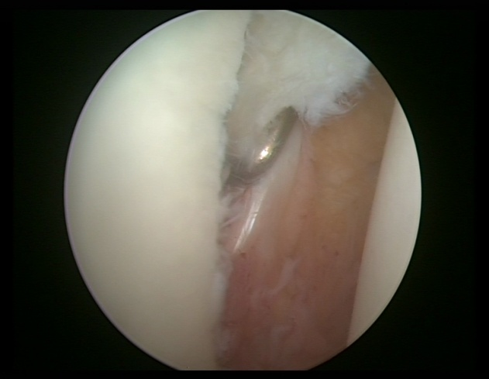
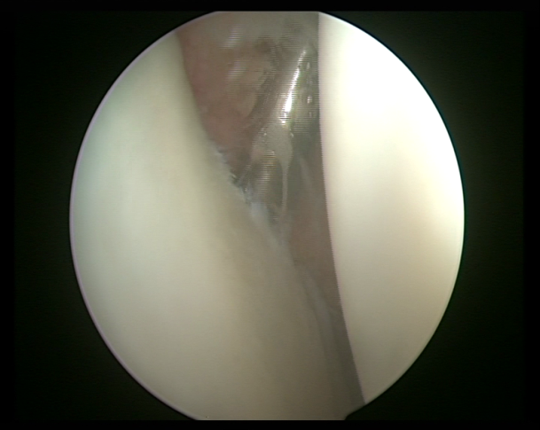
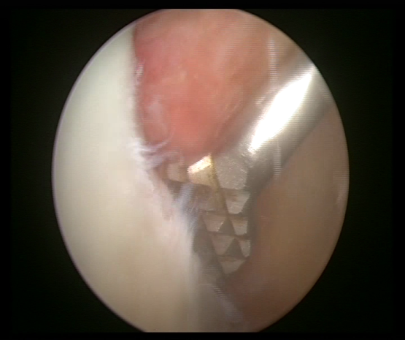
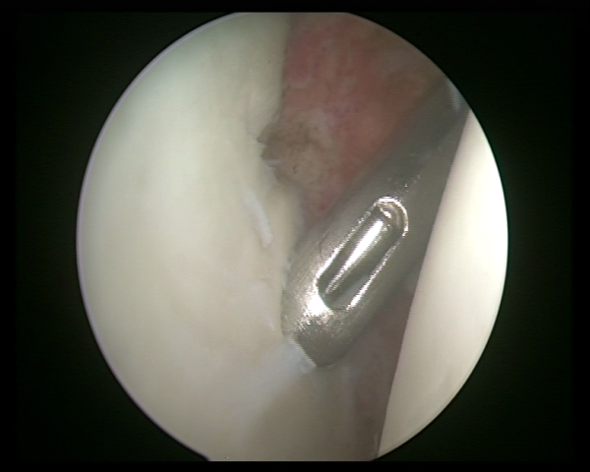
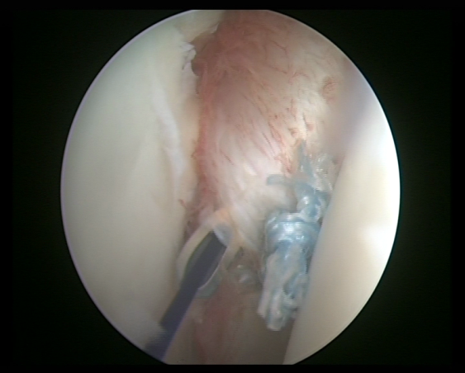
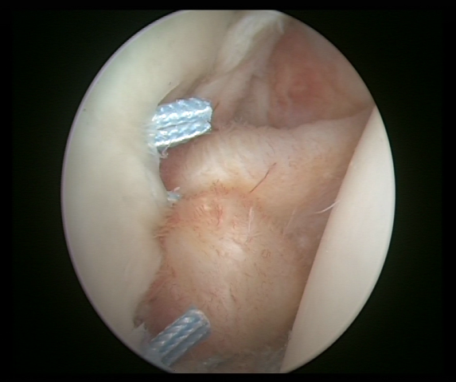
COMBINED ARTHROSCOPIC REPAIR OF ROTATOR CUFF RUPTURE AND BANKART LESION ASSOCIATED WITH ANTERIOR DISLOCATION OF THE SHOULDER
Surgical technique for Bankart repair ( right shoulder)

Slide 15
COMBINED ARTHROSCOPIC REPAIR OF ROTATOR CUFF RUPTURE AND BANKART LESION ASSOCIATED WITH ANTERIOR DISLOCATION OF THE SHOULDER
Technique for Rotator cuff tear :
First arthroscopic acromioplasty
We used titanic metal screws (5,5mm), each one contained 2 or 3 non absosbable sutures (fiber wire) N0 2 for RC repair
Mean two (1-4) screws for each patient
Biceps tenodesis in three cases
SLAP lesion was not repaired

Slide 16
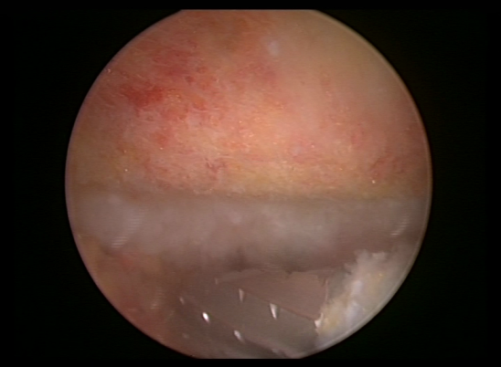
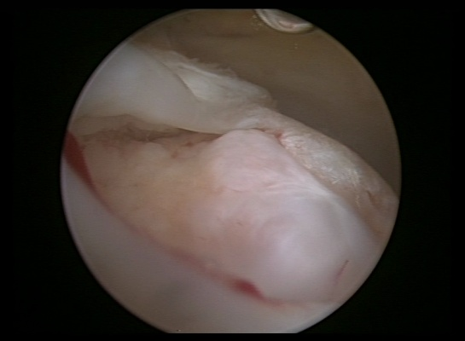
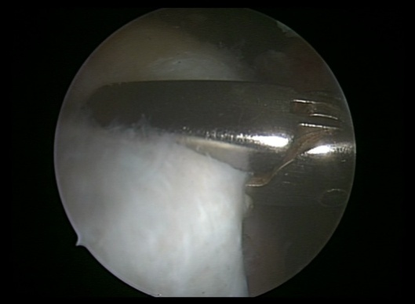
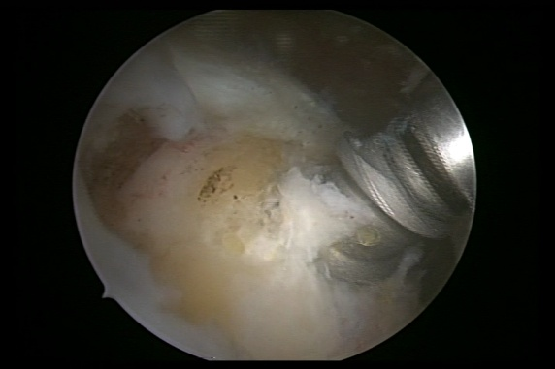
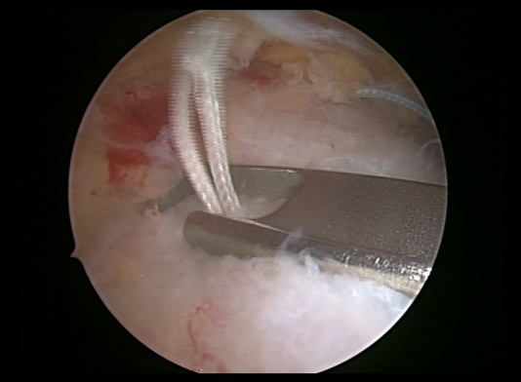
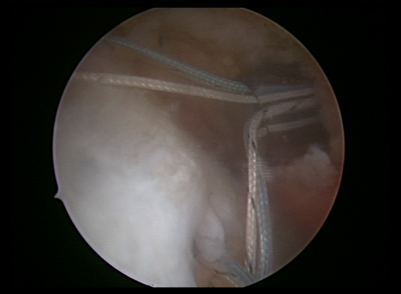
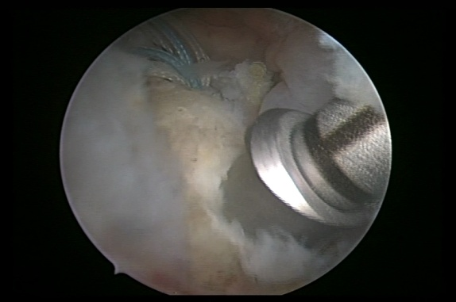
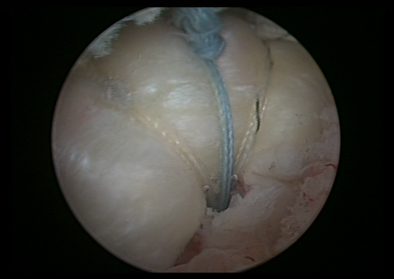
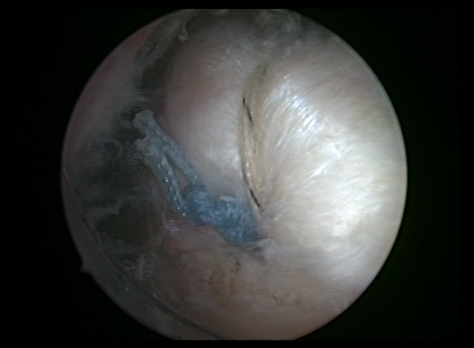
Technique for Rotator cuff repair (right shoulder)
2,5 cm crescent type

Slide 17
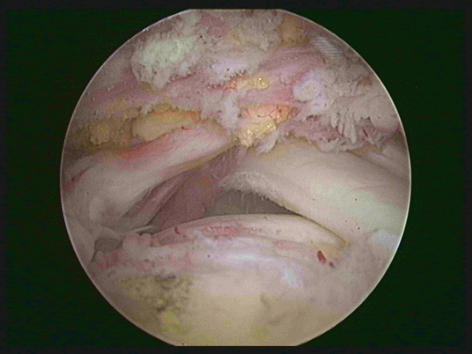
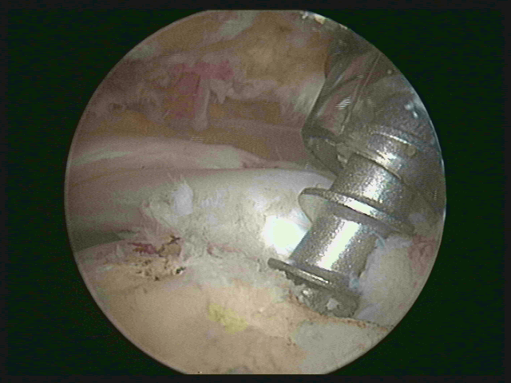
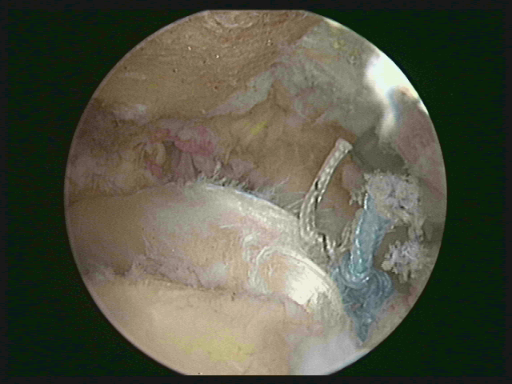
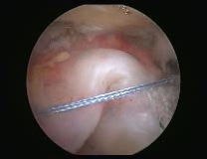
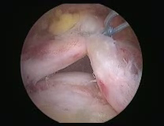
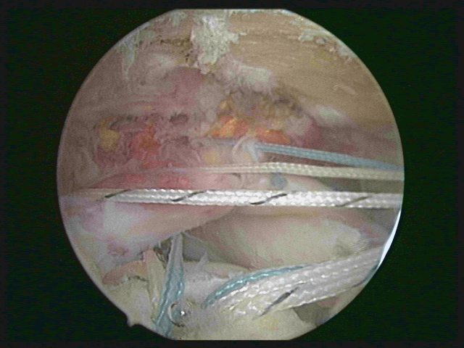
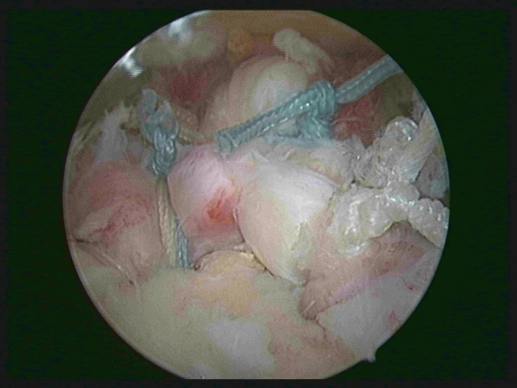
Technique for Rotator cuff repair (right shoulder)
Massive tear (U shape)

Slide 18
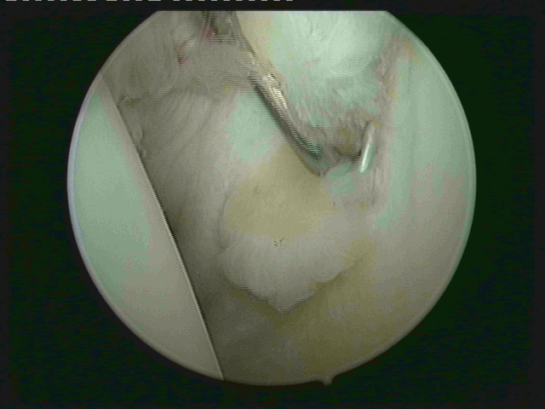
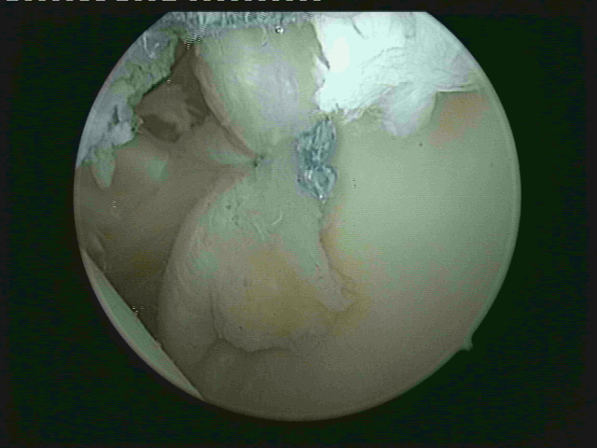
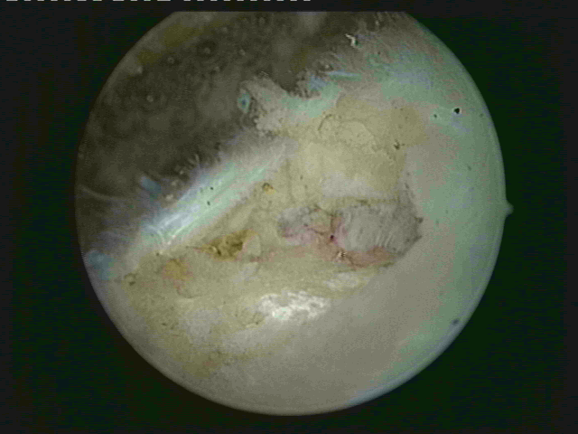
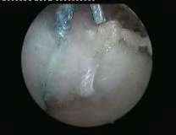
COMBINED ARTHROSCOPIC REPAIR OF ROTATOR CUFF RUPTURE AND BANKART LESION ASSOCIATED WITH ANTERIOR DISLOCATION OF THE SHOULDER left shoulder

Slide 19
COMBINED ARTHROSCOPIC REPAIR OF ROTATOR CUFF RUPTURE AND BANKART LESION ASSOCIATED WITH ANTERIOR DISLOCATION OF THE SHOULDER
Postoperative physiotherapy and rehabilitation :
A : Protection in an arm sling for 3 weeks
All pts started early daily pendulum motions and
gentle excersises with passive forward flexion till 90°-100° between 2nd -4th week.
Avoided external rotation for 4 weeks
B: Passive and assisted flexion, abduction without
restriction between 4th-8th week
C: Active flexion and abduction (without weight)
about 8 weeks postoperatively
D: RC strengthening and scapular stabilizing excercises
with light weight after 10- 14 weeks

Slide 20
COMBINED ARTHROSCOPIC REPAIR OF ROTATOR CUFF RUPTURE AND BANKART LESION ASSOCIATED WITH ANTERIOR DISLOCATION OF THE SHOULDER
UCLA scoring system (35 points) :
Pain (10 points)
Function (10 points)
Active forward flexion ( 5 points)
Strength of forward flexion ( 5 points)
Satisfaction of the patient ( 5 points)
Excellent (34-35 points)
Good (29-33 points)
Poor ( < 29 points)

Slide 21
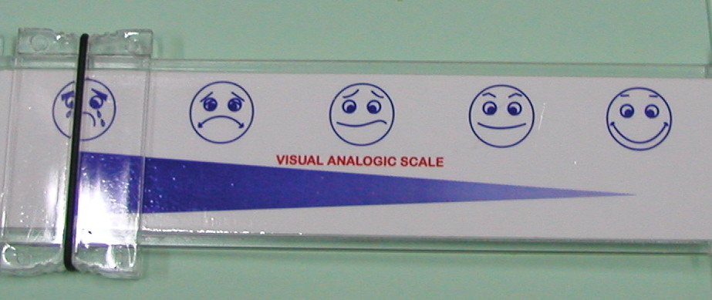
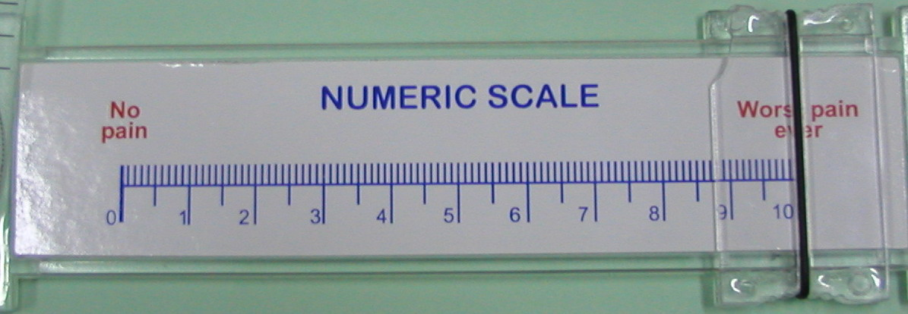
COMBINED ARTHROSCOPIC REPAIR OF ROTATOR CUFF RUPTURE AND BANKART LESION ASSOCIATED WITH ANTERIOR DISLOCATION OF THE SHOULDER visual analogic scale
Satisfied from final result 8/9 patients

Slide 22
COMBINED ARTHROSCOPIC REPAIR OF ROTATOR CUFF RUPTURE AND BANKART LESION ASSOCIATED WITH ANTERIOR DISLOCATION OF THE SHOULDER
Postoperative clinical results :
Pain relief in 8 out of 9 patients in daily activities
Mean active flexion: 160°,
Mean passive flexion 165°.
Mean active abduction: 150°
Mean passive abduction 160°.
None of the patients sustained any new episode of dislocation and all nine patients expressed their satisfaction regarding stability and strength of their shoulder
UCLA scoring system showed six out nine patients had excellent or good results.

Slide 23
COMBINED ARTHROSCOPIC REPAIR OF ROTATOR CUFF RUPTURE AND BANKART LESION ASSOCIATED WITH ANTERIOR DISLOCATION OF THE SHOULDER
Comparative results
Direction | Pre-operative Motion | Post-operative Motion | Mean Difference
Active Flexion | 135° | 160° | 25° [18.5%]
Passive Flexion | 165° | 165° | 0°
Active Abduction | 110° | 150° | 40° [36%]
Passive Abduction | 130° | 160° | 30° [23%]
Internal Rotation | T11 [T6-L3 ] | T10 [T6-L2 ] | 1 Vertebral Level

Slide 24
COMBINED ARTHROSCOPIC REPAIR OF ROTATOR CUFF RUPTURE AND BANKART LESION ASSOCIATED WITH ANTERIOR DISLOCATION OF THE SHOULDER
Comparative results
 | Pre-operative | Post-operative
Apprehension Test | 9 | Nil
Impingement sign(Neer Test (Supraspinatus) | 9 | Nil
Painful Arc | 9 | Nil
Dropping Sign [ Infraspinatus ] | 3 | 1
Napoleon Sign [ Subscapularis ] | 2 | Nil

Slide 25
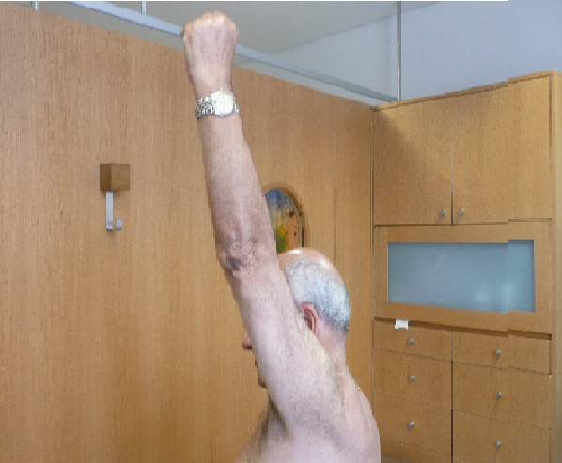
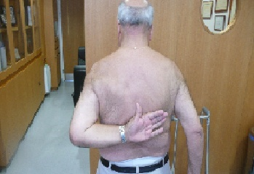
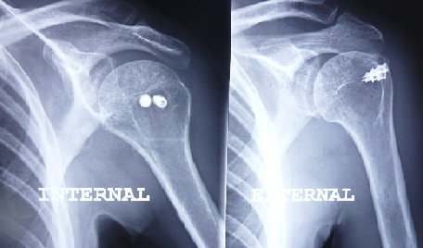
COMBINED ARTHROSCOPIC REPAIR OF ROTATOR CUFF RUPTURE AND BANKART LESION ASSOCIATED WITH ANTERIOR DISLOCATION OF THE SHOULDER

Slide 26
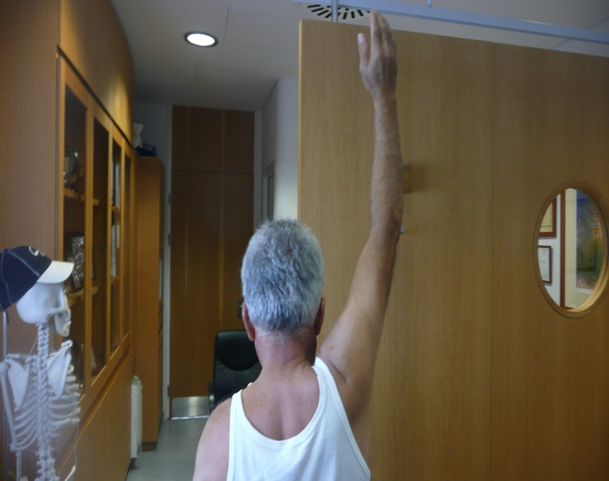
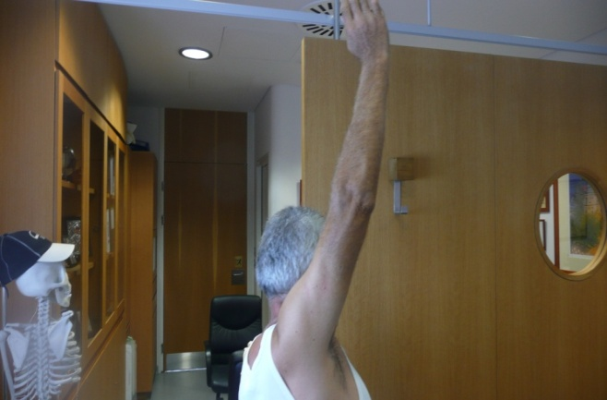
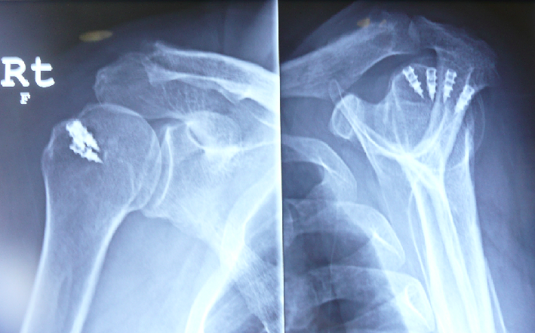
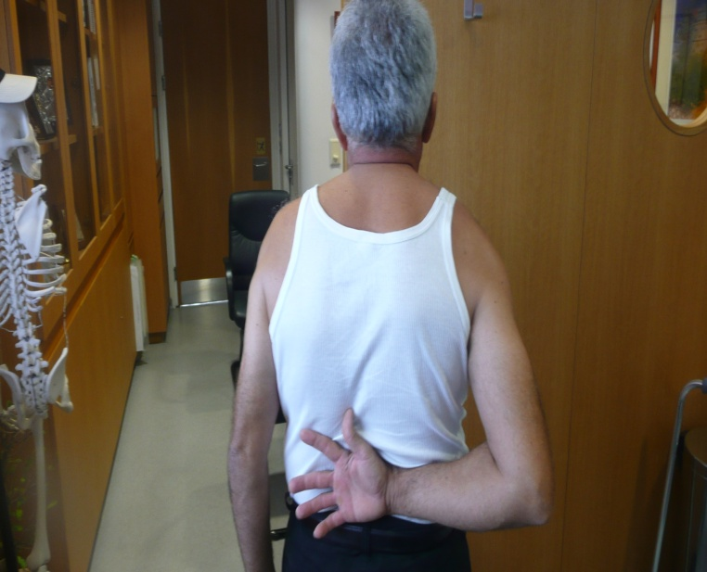
COMBINED ARTHROSCOPIC REPAIR OF ROTATOR CUFF RUPTURE AND BANKART LESION ASSOCIATED WITH ANTERIOR DISLOCATION OF THE SHOULDER

Slide 27
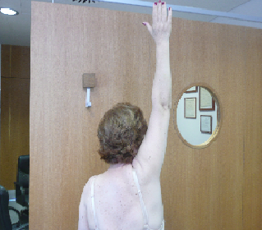
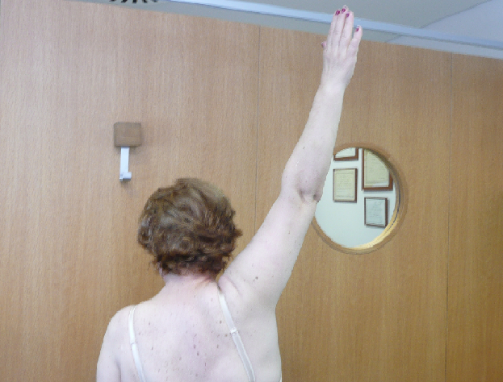
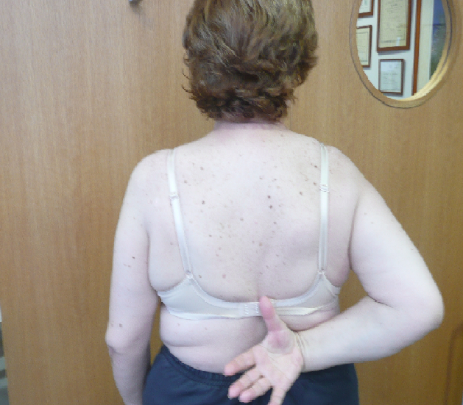
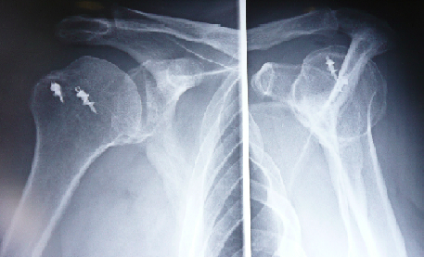
COMBINED ARTHROSCOPIC REPAIR OF ROTATOR CUFF RUPTURE AND BANKART LESION ASSOCIATED WITH ANTERIOR DISLOCATION OF THE SHOULDER

Slide 28
COMBINED ARTHROSCOPIC REPAIR OF ROTATOR CUFF RUPTURE AND BANKART LESION ASSOCIATED WITH ANTERIOR DISLOCATION OF THE SHOULDER
Conclusions :
Is important to emphasize the need to look for rotator cuff tears and instability signs when evaluating shoulder dislocation in older population
Simultaneous arthroscopic repair of Bankart lesion and rotator cuff tear gives stability and satisfactory results of patients who sustained dislocation of their shoulder

Slide 29
Referrences
G. Porcellini et al.(Arthroscopy vol 22,(March 2006)
….the “anterior mechanism”, anterior capsular-labral detachment seems to be the main cause of shoulder dislocation.

Slide 30
Thanks

