Slide 1


Midshaft Clavicle Fracture
Operate or Not
3nd MEDITERRANEAN TRAUMA CONFERENCE
Larnaca, Cyprus
23-25 September 2016
Dr Louis Christodoulou
Orthopaedic and Upper Limb Surgeon
ARETAEIO Hospital, Nicosia, Cyprus

Slide 2
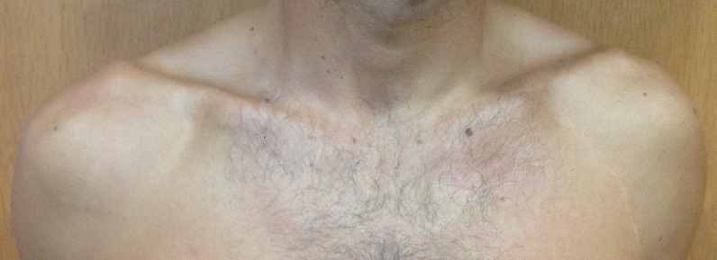
Why is so important bone
Clavicle bone

Slide 3
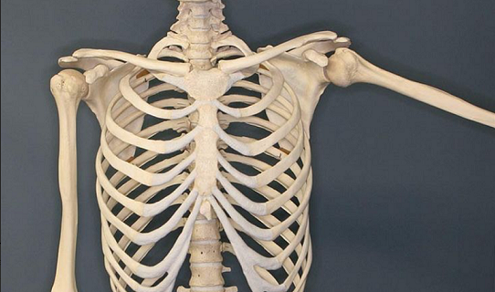
Anatomy and biomechanics
S - shaped bone
Is the only bony connection of the arm to the sternum and axial skeleton with a Strut and a Suspensory function
Protraction, Retraction, Depression and Rotation

Slide 4
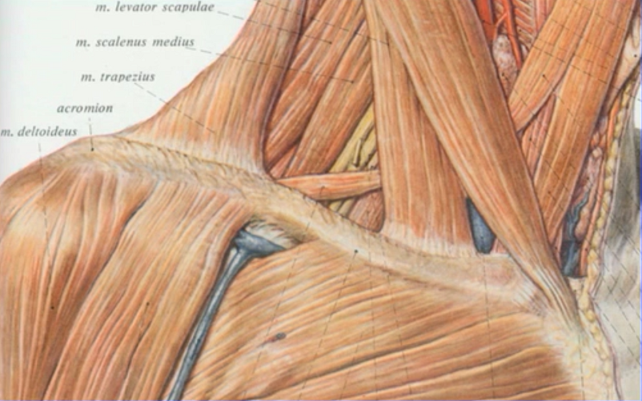
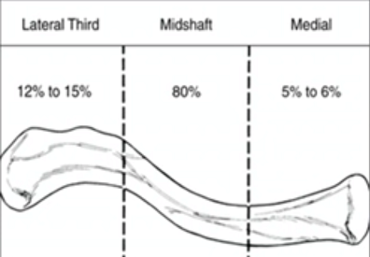
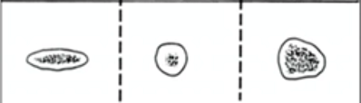
Epidemiology
4% of adult fractures
35%- 44% of all shoulder
girdle fractures
Lateral 15-20 %
Middle 1/3 80-85 %
Medial 0-5 %
Incidence
2/100,000 of population/ y
Incidence
2-4 per 100,000 of population per year

Slide 5
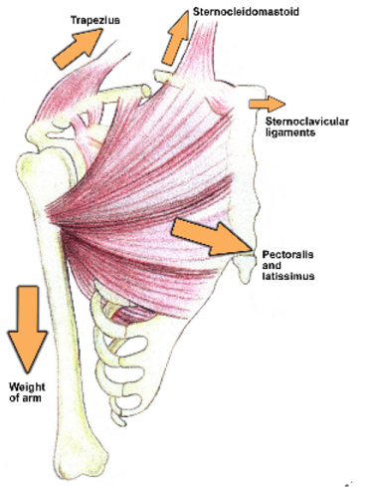
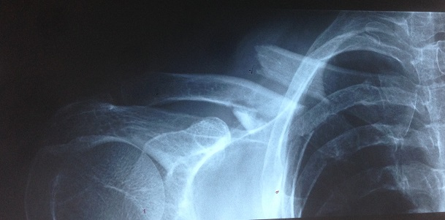
Medial clavicular fragment elevated by Sternocleidomastoid
Distal clavicular fragment
A. pulled inferiorly by Deltoid
+ weight of arm
B. displaced medially by Pectoralis M.
C.anterior translated

Slide 6
Goal of clavicle fracture Treatment
Achieve bony union while Minimizing
Dysfunction, Morbidity and Cosmetic deformity
Are all Clavicle Fractures the same?
Do all Clavicle Fractures Behave the same?

Slide 7
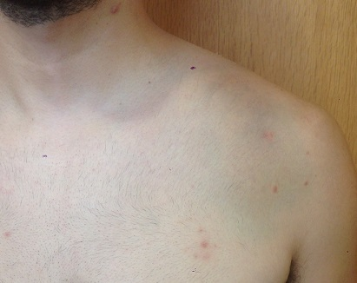
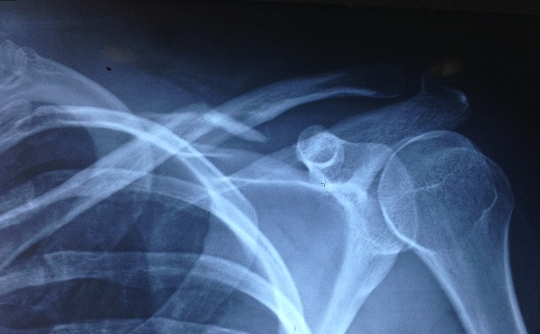
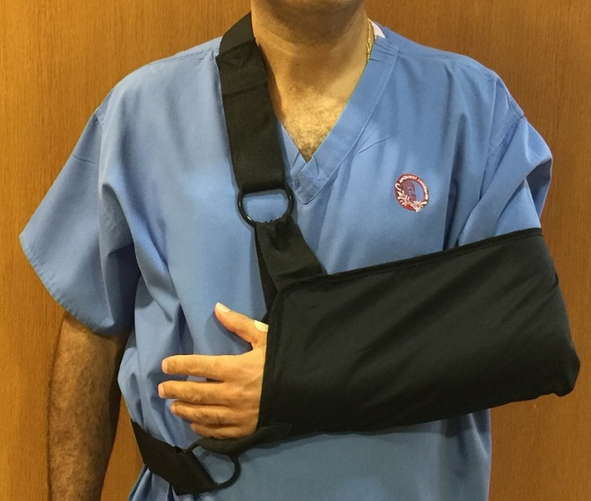
Midshaft clavicle fracture
Non-displaced or minimally displaced
Non-operative
treatment
Sling
or Figure of 8 bandage

Slide 8
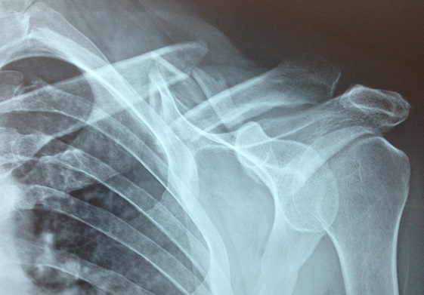
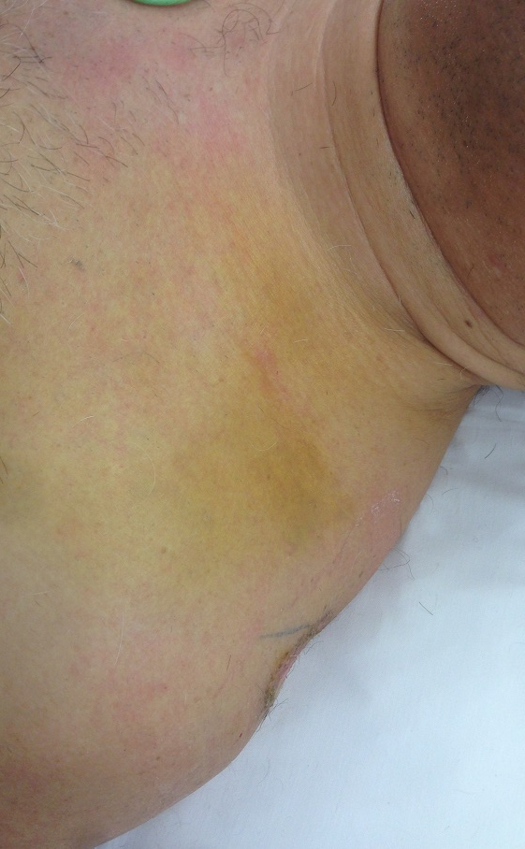
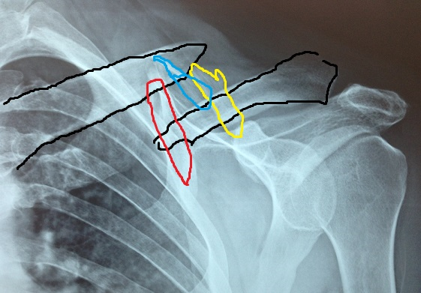

Treatment ??
39y,male, skiing inj.

Slide 9
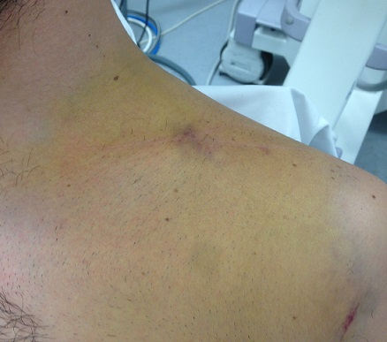
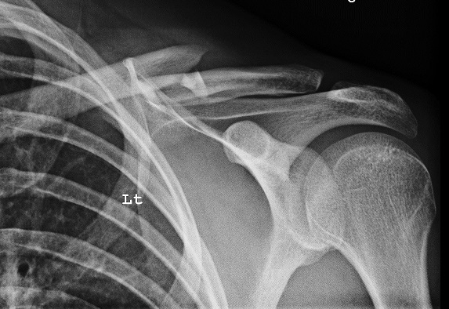
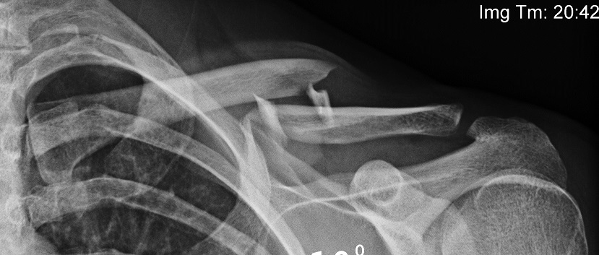

Midshaft Clavicle fracture
Radiographic evaluation
25y,male, bicycle injury
AP view
30⁰ cephalic tilt , AP view
(Z type fracture)

Slide 10
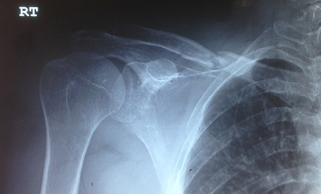
Midshaft Clavicle fracture
Radiographic evaluation
59 y, female, RTA (vehicle collision)
60% of pts with High Energy Injury sustain 100% displacement
John Riehl et. al, Can J Surg 2014 jun.57(3)
1st Day
7th Day

Slide 11
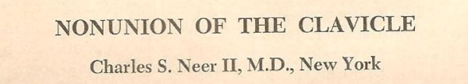
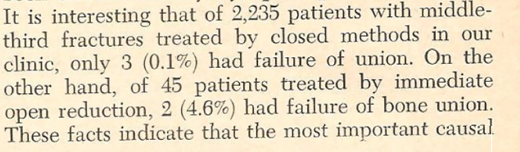
Controversy
Classic article, 1960
Non union thought to be rare for mid-shaft 0.1%
Malunion not discussed
Open treatment most common cause of nonunion, 4,6%
Non operative management treatment of choice

Slide 12
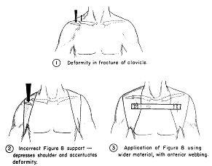
Controversy
An atlas of anatomy and treatment of midclavicular fractures. Clin Orthop. Relat. Res.
Carter R. Rowe,M.D
Classic article, 1968
...... with closed treatment non union rarely occurs (4/566).
Non operative management treatment of choice

Slide 13
WILL MY CLAVICLE HEAL AND FUNCTION WELL ?
Historically most papers have looked at healing rates
Function has only been recently analyzed

Slide 14
The etiolology and management of clavicular fractures has changed a lot in the last 20 years
High energy + complex injuries are more than in past
The chances to reduce anatomically a displaced clavicle fracture conservatively is slim
Three possible non operative outcomes
Asymptomatic Malunion
Symptomatic Malunion
Nonunion

Slide 15
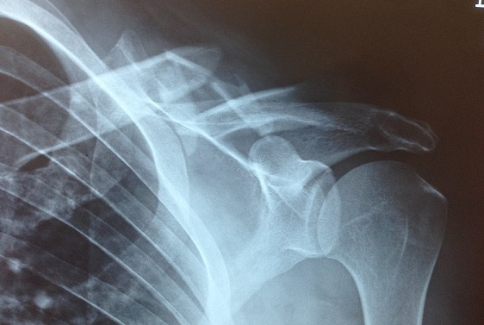

JBJS Br, 1997
15% developed nonunion(8/52)
31% pts reported unsatisfactory results regardless the healing (16/52)
Increased risk of nonunion with
initial shortening
> or =2 cm

Slide 16
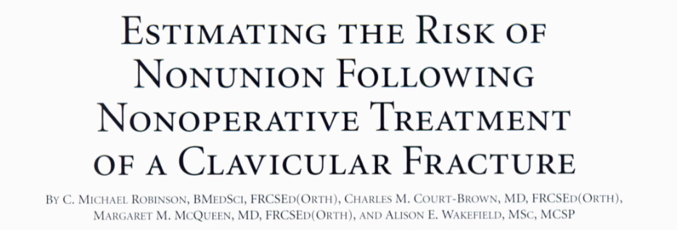
M
JBJS VOLUME 88-A Number 7. JULY 2004
Significantly increased only by :
Advancing age
Female gender
Complete displacement of the fracture
Presence of comminution

Slide 17
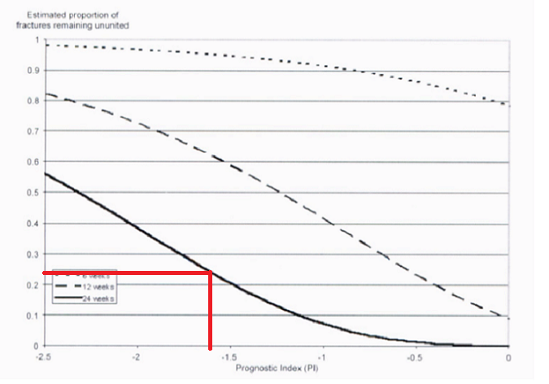
Prognostic index
[-0,85 x (1 if displaced or 0 if undisplaced)]+[-0.36x (1 if female or 0 if male)] +[-0.37x(1 if comminuted or 0 if non comminuted fr.)]+[-0.01x( age of patient in years)]
Prognostic index: -1,61
Estimated nonunion in 24w: 23%
Displaced , Male, Comminuted, 39 y

Slide 18
Deficits following Nonoperative treatment of displaced clavicle fractures
McKee, Pedersen, Jones JBJS Am 2006
Patient- based and Surgeon based Outcome questionnaire
( measured with DASH, Constant score)
50% Satisfied
50% Partially satisfied or Dissatisfied
Objective shoulder muscle-strength testing
82% for max abduction, 67% for endurance of abduction
Up to 30% demonstrated residual strength deficits in shoulder

Slide 19
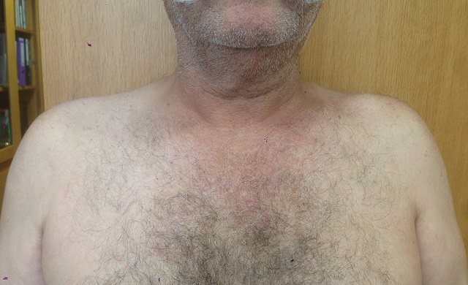
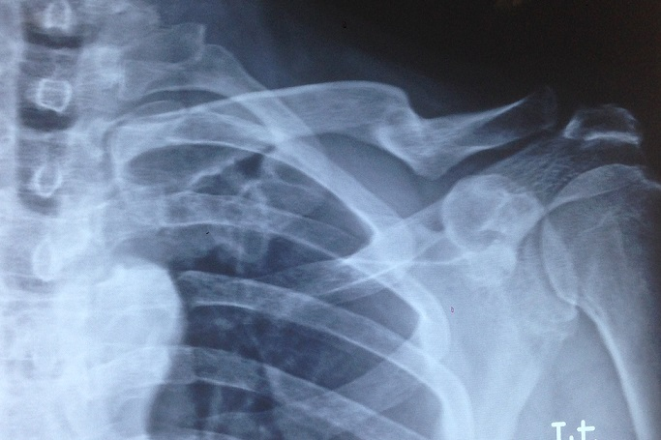
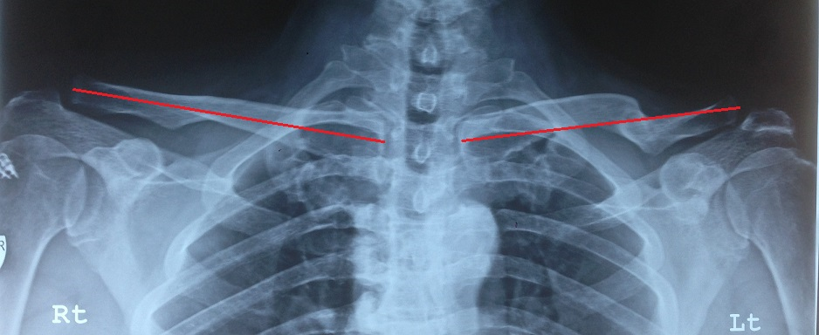

Symptomatic Malunion
66y male, manual worker, Nonoperative treatment
Left clavicle injury 16 yrs ago

Slide 20
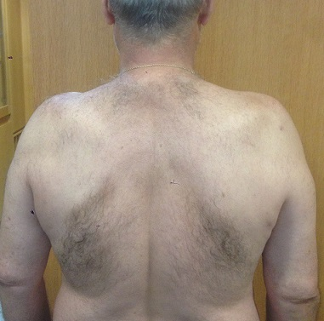
Symptomatic Malunion
(after Non operative treatment)
Incidence 15-20%
Decrease the size of thoracic skeleton
Shoulder shrinks, shifts down
Weakness of the shoulder
Easy fatigueability
Pain with repetitive work
Paraesthesia with overhead
activity

Slide 21
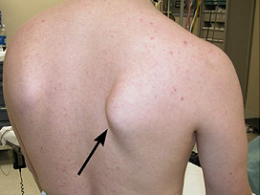
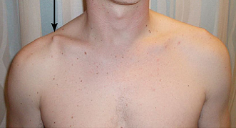
Winging due to Scapular malposition Rockwood and Green’s, 2015
Symptomatic Malunion or Nonunion
*PROTRACTED Shoulder
*Increased anterior version of scapula

Slide 22
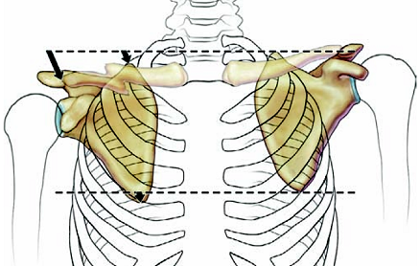
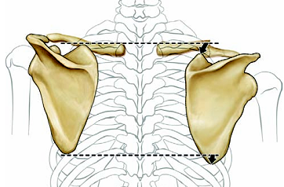
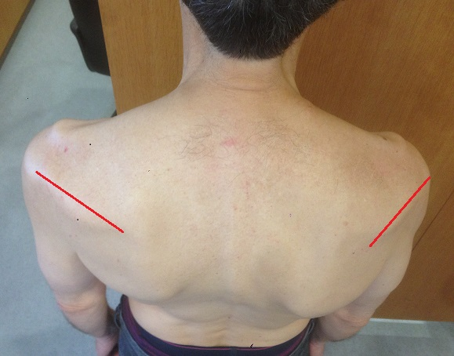
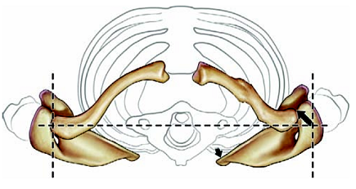
Winging due to Scapular malposition
Non operative treatment, Ristevski et al,JSES,2013

Slide 23
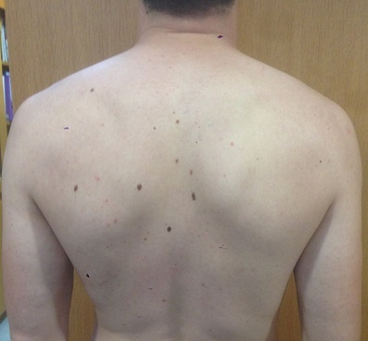
Scapular dyskinesis following Displaced fractures of the middle clavicle J Shoulder Elbow S (2015)
E. Shields et al,
37 % of patients( 1/3Pts)
Female> males
These pts had more pain
Worse functional shoulder
scores
....... Surgical fixation reduces pts risk of developing
dyskinesis of the scapula

Slide 24
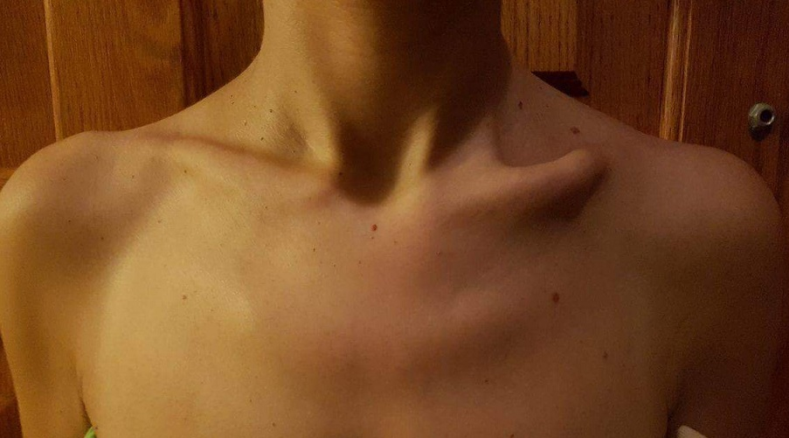
Cosmesis deformity

Slide 25
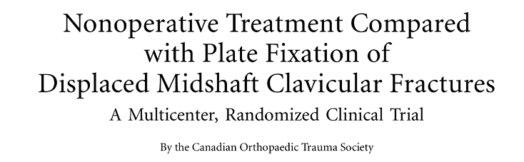
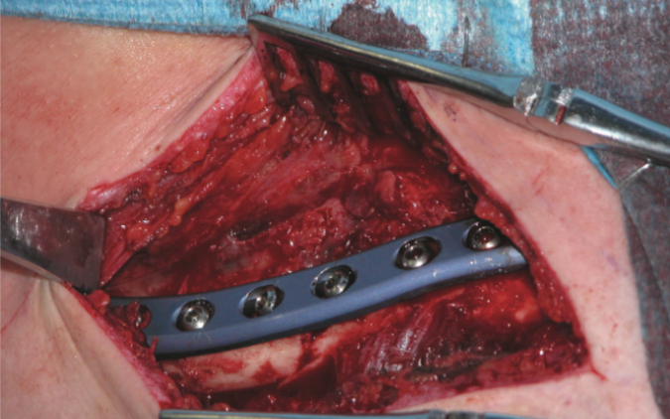
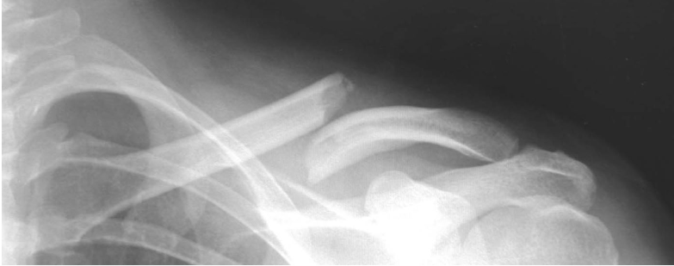
Landmark paper
JBJS Am. 2007

Slide 26
Canadian Orthopaedic Trauma Society JBJS Am. 2007
Randomized prospective trial 132 pts, > 1year follow- up
Non-operative group 49/111 pts
Mean time to radiographic Union : 7 months (28,4 w)
COMPLICATIONS: 31 (63%)
Nonunion 7+1* /49 ( 16%)
Symptomatic Malunion 9/49 ( 18,5%)
Reflex Sympathetic dystrophy 1
Transient brachial plexus symptoms 7

Slide 27
Canadian Orthopaedic Trauma Society JBJS Am. 2007
Randomized prospective trial 132 pts
Operative group 62/ 111 pts
Mean time to radiographic Union : 4 months ( 16,4 w)
COMPLICATIONS: 23 (37%)
Nonunions 2/62 (0,032%)
Malunion 0/62( none)
Local irritation and plate removal 5
Wound infection 3
Transient brachial plexus symptoms 8
Early hardware failure 1

Slide 28

Canadian Orthopaedic Society CONCLUSION
Early primary plate fixation of completely displaced midshaft clavicular fractures
results in:
.Decreased nonunion rate( 2/62 versus 7/49)
.Decreased sympt. malunion (0/62 versus 9/49)
. Improvement of Shoulder function scores
.Earlier return to function

Slide 29

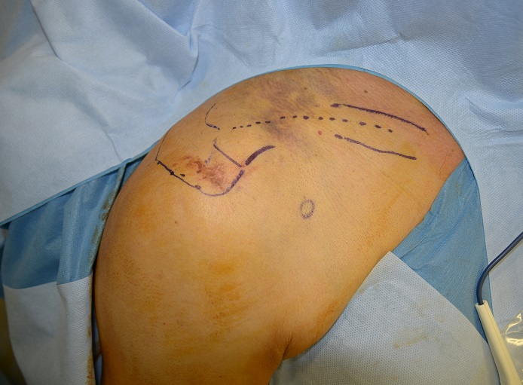
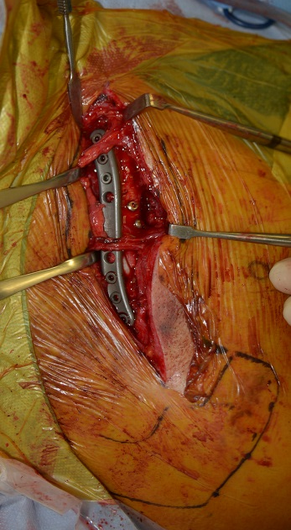
OPEN SEASON
Right Sh

Slide 30
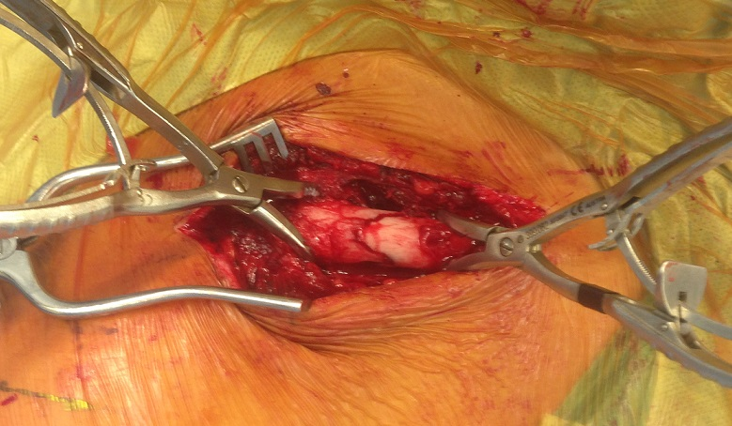
Goals of Clavicle Operation
(Plate fixation or Intramedullary nailing)
Correct Length and Rotation of fragments
Avoidance Malunion/Nonunion/Cosmesis def.
Early return to function and work

Slide 31
Indications(urgent) for Operation
OPEN displaced clavicle fracture
NEUROVASCULAR injury
FLOATING shoulder with displaced clavicle and an unstable scapula fracture
Serious SKIN tenting due to severe displacement
Multiple trauma with requirement for early arm use
FLAIL chest where breathing is compromised when drooping of the shoulder on damaged area

Slide 32
Indications(relative) for Operation
High demand, Active, Healthy, >16yrs -60 yrs
Fracture specific
Severe displacement >100%
Comminution(> 3 fragments)or segmental fractures and
Shortening more than 2cm
Patient factors
Unable to tolerate closed immobilization such as neurologic problems( parkinsonism)
Patient motivation for rapid return of function(sports, job)

Slide 33
Contraindications for Operation
Open fractures without soft tissue cover
Active INFECTION in operative area
Non compliant pts and SUBSTANCE abuse
Skin Burns over the fracture side
Previous soft tissue irradiation in operative area
Elderly pts with sedentary life style

Slide 34
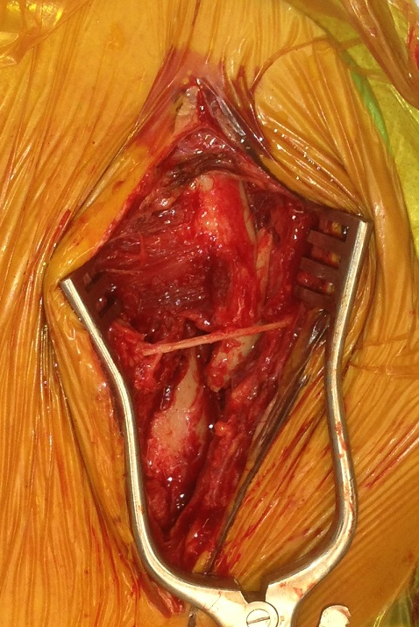
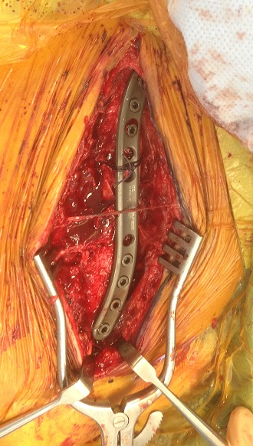
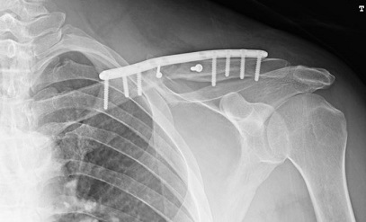

Plate fixation surgical technique (Left clavicle) anterosuperior approach

Slide 35
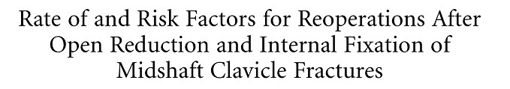
Complications of Operation
                Leroux et al JBJS Am. 2014
25% out of 1350 pts required reoperation
Most common :
Implant removal 254 (19%)
Nonunion 35/1350 ( 2,6%)
Deep infection 35/1350 (2,6%)
Malunion 15/1350 ( 1,1%)
Pneumothorax 16/1350 (1.2%)
Brachial plexus and suclavian vessel injury ,<5

Slide 36
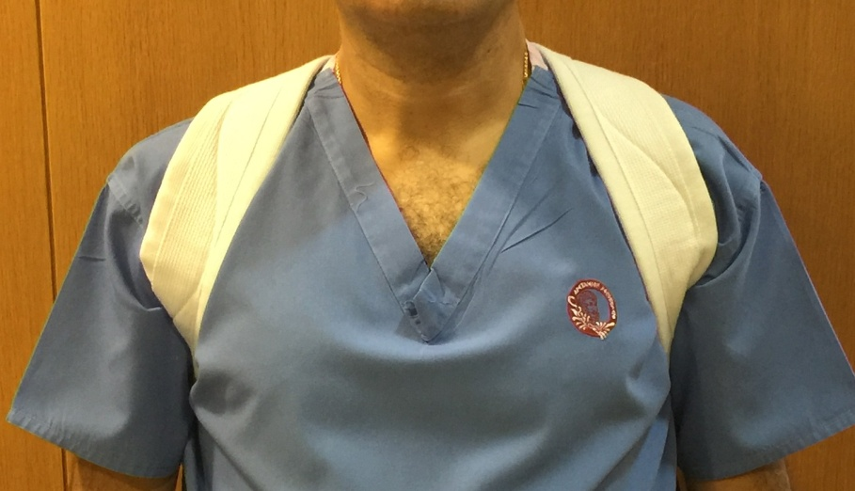
Summary- Conclusion Midshaft clavicle fracture
Non-displaced or Minimally Displaced
Conservative
treatment
Sling
or Figure of 8 bandage
Bone Joint J 2015;97-B:1562
Acta Orthop Scand 1987 ; 58: 71

Slide 37
Summary-Conclusion
Pts with Displaced midshaft clavicle fractures:
Operative treatment has superior results in selected cases
We don’t support routinely operation for all fractures
Clavicle deformity ( especially shortening, >15mm) leads to measureable loss of strength
Pts have a higher risk of sustaining Nonunion(15%)
and Symptomatic Malunion(15-20%) if the fracture
is treated conservatively.

Slide 38
Conclusion - Take home message
Treatment should be individualized with consideration of age , activity job and expectations of treatment. Operative treatment is reserved for active, healthy pts with completely displaced fractures and obvious clinical deformity
Patient and Surgeon should decide together (joint decision) how to treat a displaced clavicular fracture discussing the risk factors of conservative treatment and the risks/benefits of surgery

Slide 39
Thank you

