Slide 1
SHOULDER Impingement Clinical examination-Diagnosis -When to operate
24th CAOST ANNUAL ORTHOPAEDIC CONFERENCE WITH EFFORT FORUM, CYPRUS
8-9 November 2014
Dr Loizos Christodoulou
Orthopaedic and Upper Limb Surgeon
ARETAEIO Hospital , Nicosia, Cyprus

Slide 2
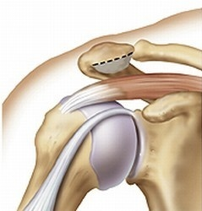
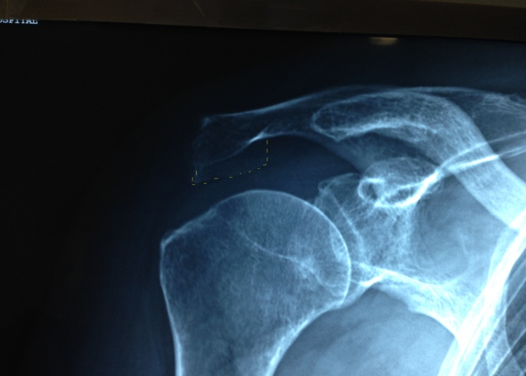
Shoulder Impingement Background
... in 1972 dr Charles Neer (USA) introduced the concept of rotator cuff impingement to the literature
stating that it results from mechanical impingement of the rotator cuff beneath the anteroinferior part of the acromion, especially in flexion and internal rotation of the arm

Slide 3
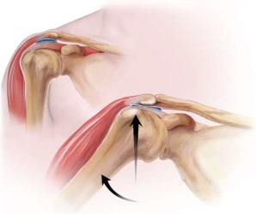
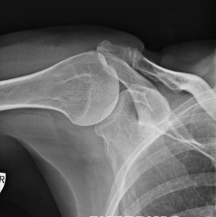
Shoulder Impingement
Is the most common disorder of shoulder
Accounts for 60% of all complains of shoulder pain
Occurs when the structures in the subacromial space
(RC, long head biceps, bursa)
become compressed under the coracoacromial arc due to narrowing of the subacromial space

Slide 4
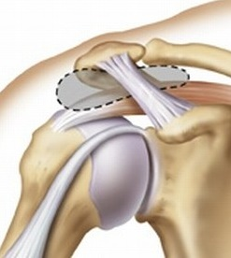
Anatomy of Subacromial space
Superior border: coracoacromial arch+ ACJ
Acromion, coracoacromial ligament, coracoid process
Inferior border : great tuberosity +humeral head
The height of subacromial space ranges from 10-15 mm
ACJ
acromion
Coracoacrom. ligament
Inside: RC tendons, LHB, bursa

Slide 5
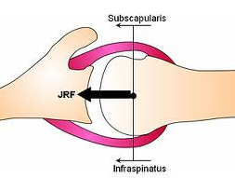
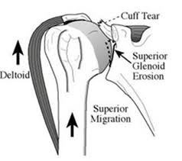
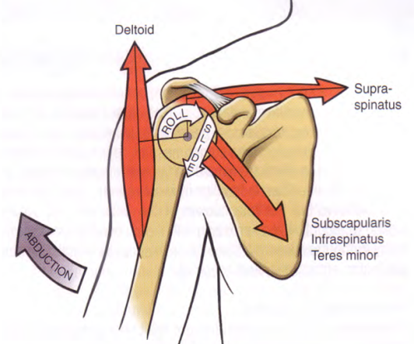
Shoulder Impingement Functional anatomy
The RC is the DYNAMIC STABILIZER of glenohumeral Joint.
The RC muscles generate torque
Also depress the humeral head on the glenoid fossa
The deltoid abducts the shoulder, forming a force couple with RC
to elevate the arm
With dysfunction of RC, the unopposed deltoid during flexion, causes cephalad migration of the humeral head
subacromial impingement

Slide 6
Shoulder Impingement Etiology
INTRINSIC mechanisms : due to degeneration (age)
(intratendinous) overuse, trauma of tendons
EXTRINCIC mechanisms: Anatomical factors
(extratendinous) Glenohumeral imbalances
Posterior capsular contracture
Scapulothoracic imbalances
PRIMARY impingement causes the impingement
SECONDARY impingement is the result of another process

Slide 7

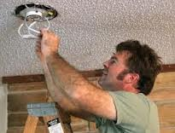
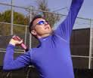
Shoulder Impingement Etiology: INTRINSIC mechanisms
Repetitive microtrauma( overuse)
Inflammation and Friction of RC against coracoacromial arch
Tendon degeneration, partial tear RC, muscle fatigue
Proximal migration humeral head
Secondary Impingement

Slide 8
Shoulder Impingement Etiology
INTRINSIC mechanisms : due to degeneration (age)
(intratendinous) overuse, trauma of tendons
EXTRINCIC mechanisms: Anatomical factors
(extratendinous) Glenohumeral imbalances
Posterior capsular contracture
Scapulothoracic imbalances
PRIMARY impingement causes the impingement
SECONDARY impingement is the result of another process

Slide 9
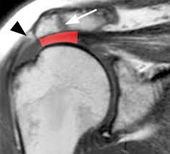
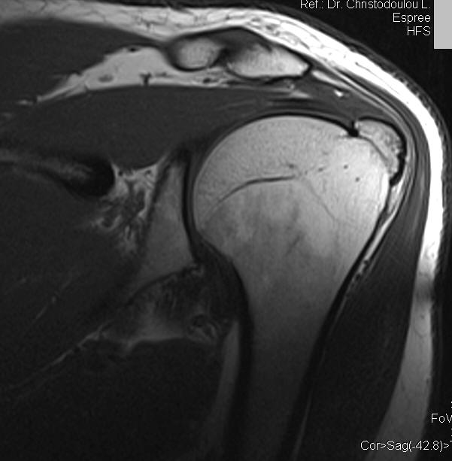
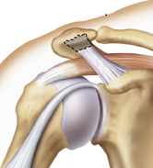
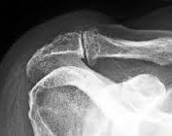
ETIOLOGY- EXTRINSIC MECHANISMS Anatomical factors e
Acromial osteophyte, Hooked acromio
Os acromiale
Prominent great tuberosity
Coracoacromial ligament hypertrophy
ACJ arthritis ( inferior osteophyte)

Slide 10
Shoulder Impingement Etiology
INTRINSIC mechanisms : due to degeneration (age)
(intratendinous) overuse, trauma of tendons
EXTRINCIC mechanisms: Anatomical factors
(extratendinous) Glenohumeral imbalances
Posterior capsular contracture
Scapulothoracic imbalances
PRIMARY impingement causes the impingement
SECONDARY impingement is the result of another process

Slide 11
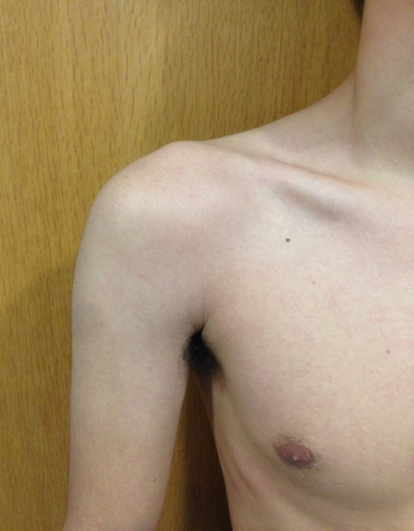
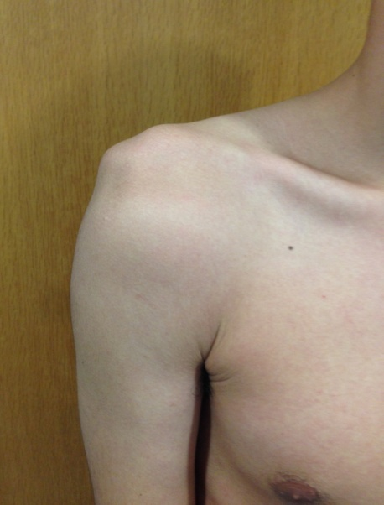
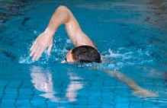
ETIOLOGY- EXTRINSIC MECHANISMS
Underlying glenohumeral instability
Young athletes who perform overhead sports activities
Repetitive stresses on static and dynamic
glenohumeral stabilizers
Weakening anterior capsule +
Dysfunction RC
Translation Humeral Head
Anterior + superiorly
Dynamic decrease of subacromial space
Secondary impingement

Slide 12
Shoulder Impingement Etiology
INTRINSIC mechanisms : due to degeneration (age)
(intratendinous) overuse, trauma of tendons
EXTRINCIC mechanisms: Anatomical factors
(extratendinous) Glenohumeral imbalances
Posterior capsular contracture
Scapulothoracic imbalances
PRIMARY impingement causes the impingement
SECONDARY impingement is the result of another process

Slide 13
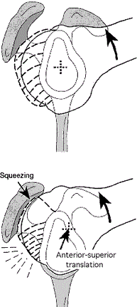
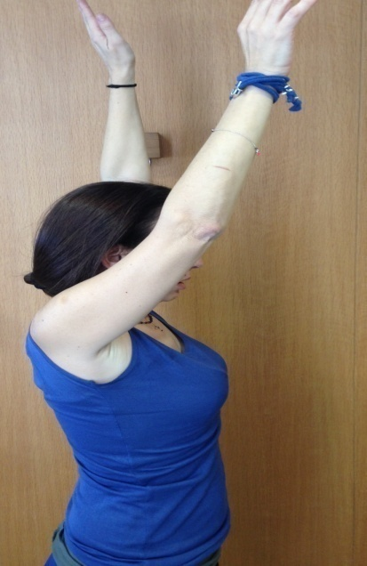
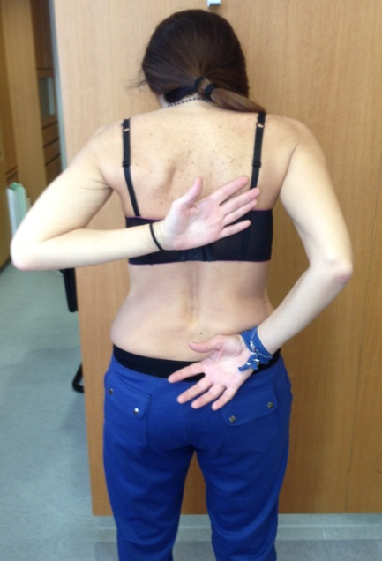
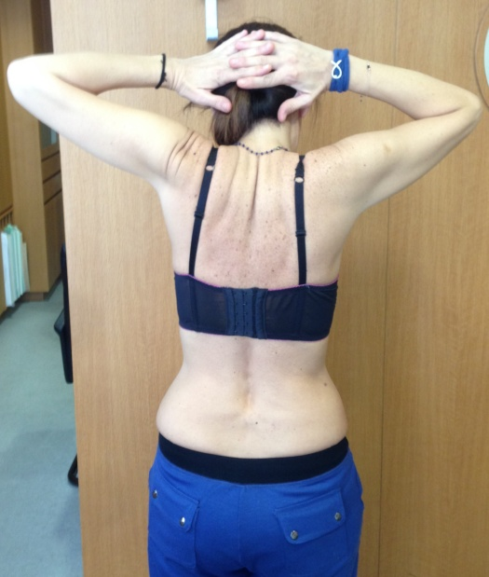
ETIOLOGY: EXTRINSIC MECHANISMS coracoid process
Posterior Capsular Contracture
(Capsular constraint mechanism)
With forward flexion acromio
Abnormal translation of humeral head
Anterior + Superiorly

Slide 14
Shoulder Impingement Etiology
INTRINSIC mechanisms : due to degeneration (age)
(intratendinous) overuse, trauma of tendons
EXTRINCIC mechanisms: Anatomical factors
(extratendinous) Glenohumeral imbalances
Posterior capsular contracture
Scapulothoracic imbalances
PRIMARY impingement causes the impingement
SECONDARY impingement is the result of another process

Slide 15
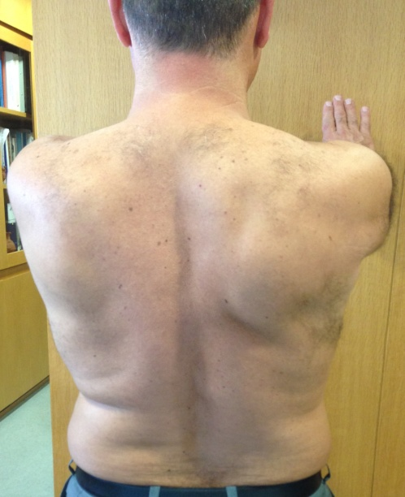
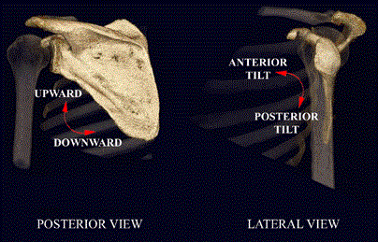
ETIOLOGY: EXTRINSIC MECHANISMS Scapulothoracic muscle imbalance
Any pathology which causes the scapula not to move properly creates (-) feedback and low activity of Serratus anterior + lower Trapezium
Dysfunction of scapular or RC muscles(tear)
ACJ instability or arthritis , Glenohumeral instability

Slide 16
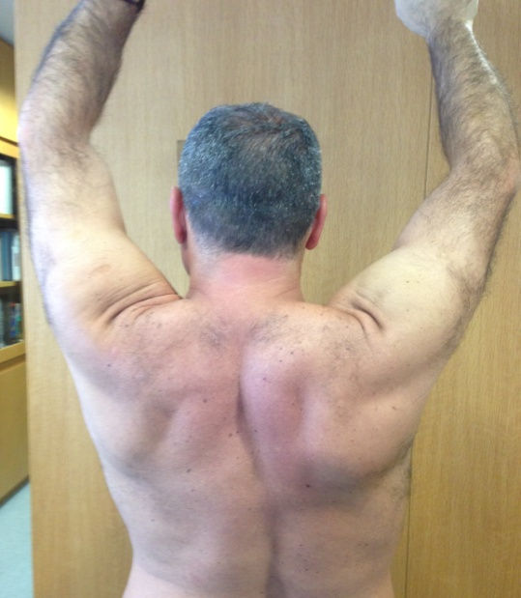
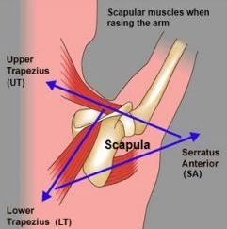
EXTRINSIC MECHANISMS - Impingement Scapulothoracic muscle imbalance
during flexion
posterior scapular tilting
WEAK upward rotation of scapula
external rotation of scapula
FAILED elevation of anterior+ lateral acromion
Premature impingement in 30⁰ -40⁰ abduction

Slide 17
Classification OF SH IMPINGEMENT
Neer (1972) divided impingement into three PROGRESSIVE stages
STAGE I: pts<25, associated with overuse injury
Bursitis + subacromial edema + haemorrhage
The syndrome is reversible Nonoperative treatment
STAGE II: Typically in pts 25-40 y
Fibrosis, tendinitis and initial development partial tear
Doesn't respond to conservative treatment
STAGE III: Usually in pts > 40 y
More chronic changes
Progression from a Partial to Complete RC tear Osteophytes along anterior acromion

Slide 18
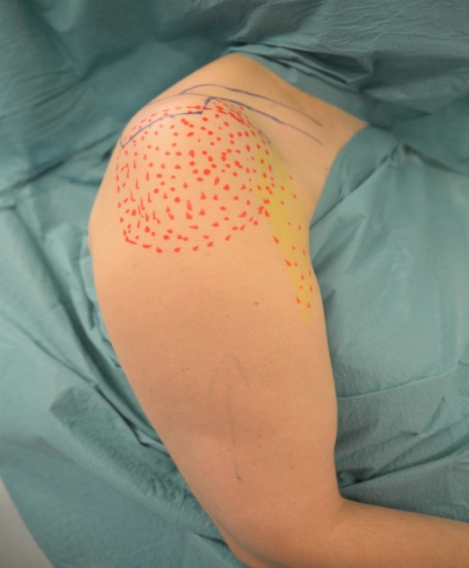
Clinical examination History
Pain(“deep” ) is the most common complain.
Night pain
Worse lying on the involved shoulder
or
sleeping with arm in overhead position
Weakness
(secondary to pain)
Stiffness

Slide 19
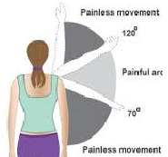
Clinical examination History-Profile of the pt
AGE: more common > 40 y, manual workers
pts< 30 may have subtle glenohumeral instability
DURATION of symptoms
Progressively , after repetitive activities over a period of weeks till months without trauma
or acutely after a major injury
PREDISPOSING FACTORS
Activities with arm in the painful arc
of 70-120⁰ of elevation or abduction
Overhead - repeated activities

Slide 20
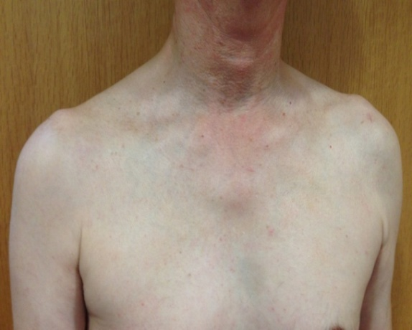
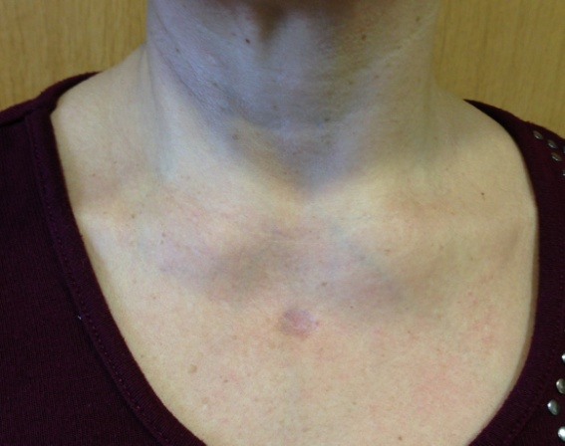
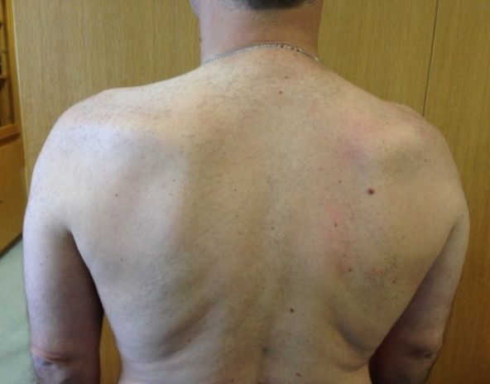
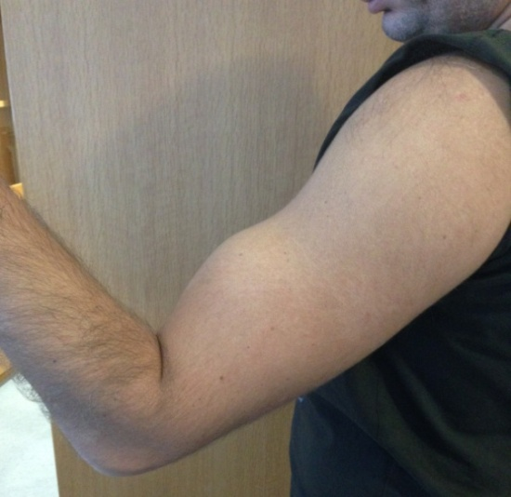
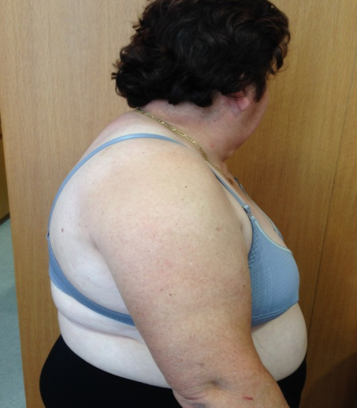
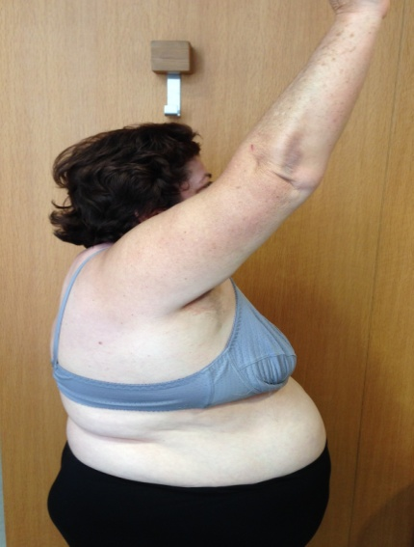
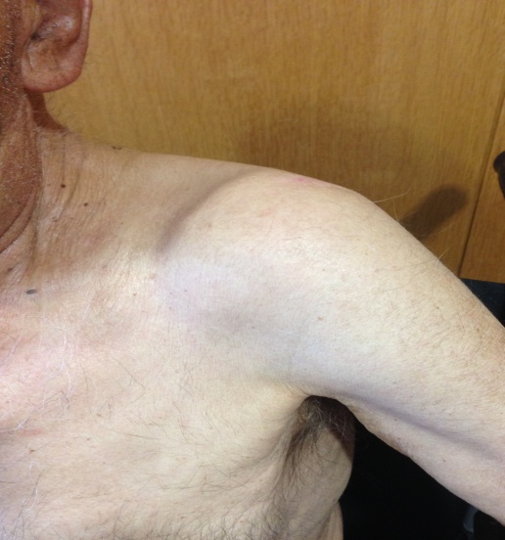
Clinical examination Inspection all shoulder girdle
Associated findings
( ACJ, Sterno , RC wasting, Biceps rupture, Kyphosis, OA )

Slide 21
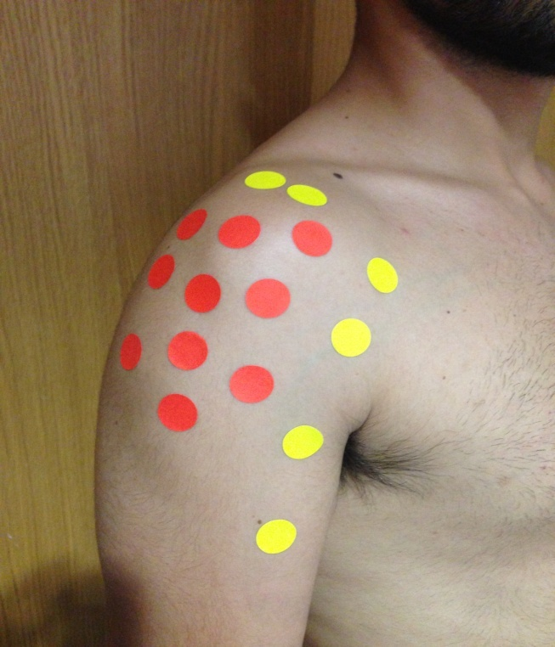
Clinical examination Palpation all shoulder girdle + neck
Localized pain in the area
of supraspinatus insertion
Pain to ACJ area + Biceps may
coexist with primary impingement
Motion: Full or nearly full range
of passive motion
Examination of RC muscle strength
Careful examination of young patients(< 30y)

Slide 22
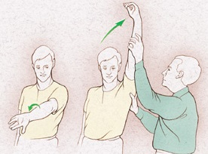
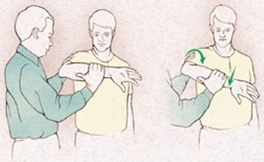
IMPINGEMENT SPECIFIC tests
Painful arc
Neer sign:
pain when forcefully elevate ( over 120⁰)
an internally rotated arm
(supraspinatus impingement against
anterior inferior acromion)
Hawkins sign:
pain on internal rotation with the arm
elevated to 90⁰
( supraspinatus impingement against
coracoacromial arch)

Slide 23
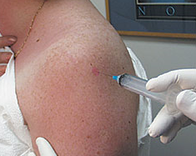
Clinical examination
Impingement test (NEER)
(subacromial injection 10 ml lidocaine)
Pain is eliminated
If Weakness persists possible RC TEAR
or cervical radiculitis
If Stiffness persists frozen shoulder

Slide 24
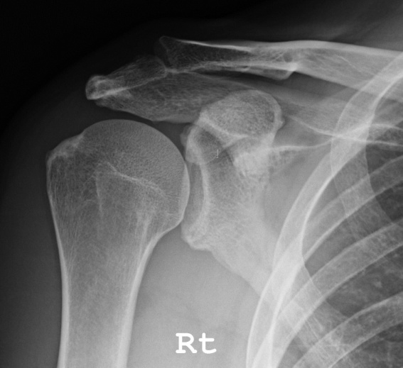
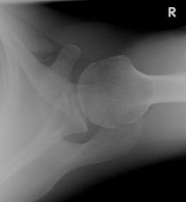
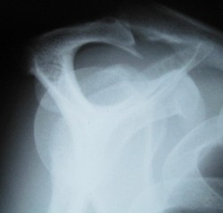
Radiographic findings
Anteroposterior, Internal , External
Axillary view Supraspinatus outlet
Early stages: normal or hooked acromion
Advanced stage:
Cystic changes to great tuberosity
Sclerosis + osteophytes anterior 1/3 acromion,
Osteophytes to ACJ or Ossification to Coracoacromial arch
Late findings
Narrow acromiohumeral gap (RC TEAR?)

Slide 25
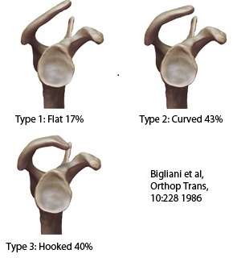
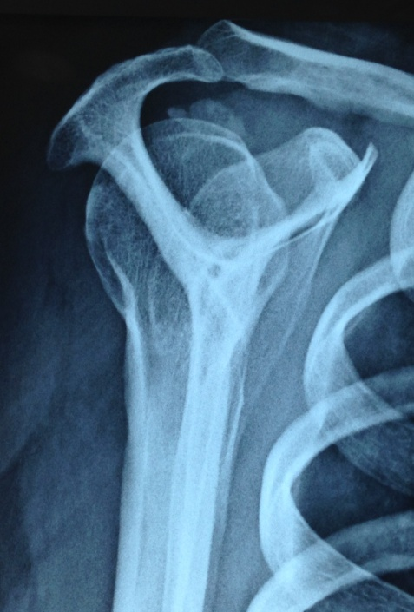
Radiographic findings SUPRASPINATUS OUTLET VIEW
Assess acromial morphology and subacromial space
Hooked acromion is associated for impingement + RC tear, due to narrowing of the supraspinatus outlet
if< 7mm

Slide 26
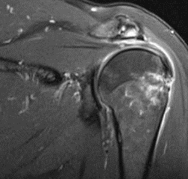
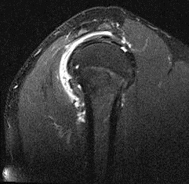
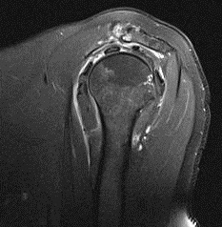
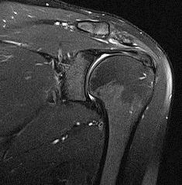
MRI scan findings- IMPINGEMENT
ACJ OA
acromial spur
subacromial
bursitis
acromial
sloping
Impingement

Slide 27
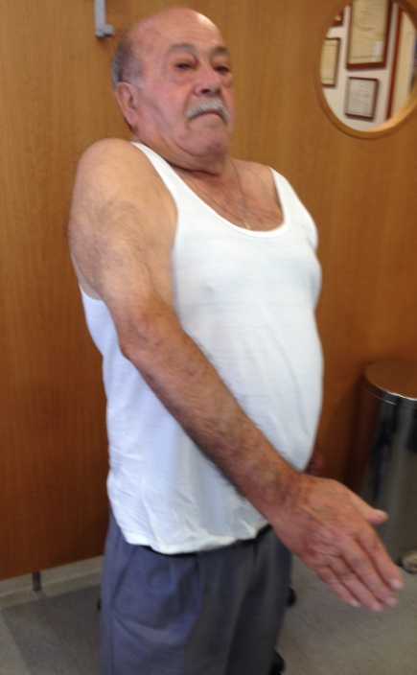
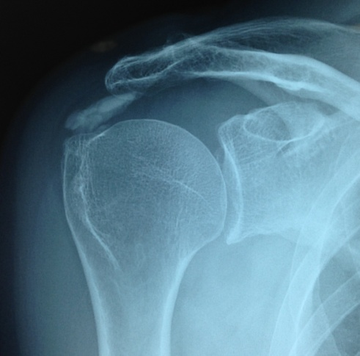
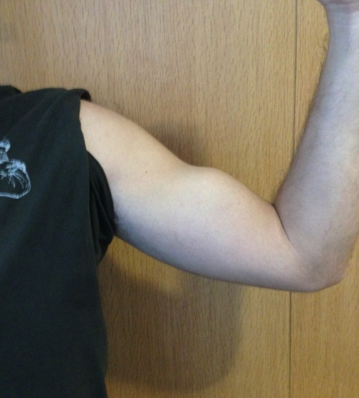
Differential diagnosis Exclude
a. Calcification b. Biceps tendinitis d. RC tear
c. biceps tear
e. Isolated ACJ OA
f. Frozen shoulder (early stages)
g. Superior labrum lesions
h. Glenohumeral arthritis

Slide 28




Differential diagnosis i. Cervical radiculopathy

Slide 29




ANTERIOR SUBCORACOID IMPINGEMENT
1909,Goldthwait , Gerber, 1985
Compression of anterior RC between Coracoid process and Lesser tuberosity
Space: Less than 6mm ( average in 11mm)
Associated with partial of full tear Subscubularis (Bigliani)
Pain on the anteromedial aspect Sh
Produced by forward elevation
and internal rotation
Neer(+), Haw(+), Horiz. Adduction test (+)
Treatment : Arthr. Coracoid Coracoplasty

Slide 30


POSTERIOR Internal impingement
1991, Walch and Jobe (posterosuperior impingement)
Impingement between articular surface of Supraspinatus and posterosuperior glenoid rim
Frequent to throwing athletes when the arm is
in Abduction + External rotation and Hyperextension
Posterior GH pain, decreased internal rotation( GIRD)
Partial intrarticular tear supraspinatus + fraying posterior labrum
Hawkins (-), Neer (-), subacromial space = normal

Slide 31
TREATMENT OPTIONS A. Non Operative Treatment
Modification of activities
Non steroid antinflammatory medication
Subacromial steroid injection
Specific physical therapy + strengthening to Deltoid, Scapular stabilizers and RC
Attention to
DYNAMIC Functional Impingement

Slide 32
B. Operative Treatment
Indications
Persistent symptoms on average of six months
or
Recurrent symptoms after repetitive conservative treatment
Best results :
A. Primary impingement due to mechanical compression and anatomical factors.
B. Chronic secondary impingement with pathologic osteophyte formation.

Slide 33
Operative Treatment
ARTHROSCOPIC ACROMIOPLASTY (Ellman)
or
OPEN ACROMIOPLASTY (Neer)
Preferred method: ARTHROSCOPIC
Subacromial bursectomy
Resection of the coracoacromial ligament
Arthroscopic anterior acromioplasty
Resection of ACJ only if there is pathology and inferior osteophyte

Slide 34
Contraindications for Acromioplasty
Underlying GLENOHUMERAL INSTABILITY
ADHESIVE CAPSULITIS
MUSCULOSKELETAL PAIN SYNDROMES
INTERNAL IMPINGEMENT
SUBCORACOID IMPINGEMENT
ISOLATED ACJ DISEASE

Slide 35




ARTHROSCOPIC technique

Slide 36




ARTHROSCOPIC technique

Slide 37
Conclusion
SHOULDER IMPINGEMENT is not the same for all pts
... not all impingements are structural
Always exclude secondary shoulder impingement
... Not always impingement needs surgery..
...Not always impingement needs acromioplasty
Detailed history and clinical examination
Correct diagnosis and safe treatment

Slide 38
ΕΥΧΑΡΙΣΤΩ
ΤΗΑΝΚ YOU

